Slide 1
Organ Transplant Data Redesign
Christine Harvey
Megan Wendell

Slide 2
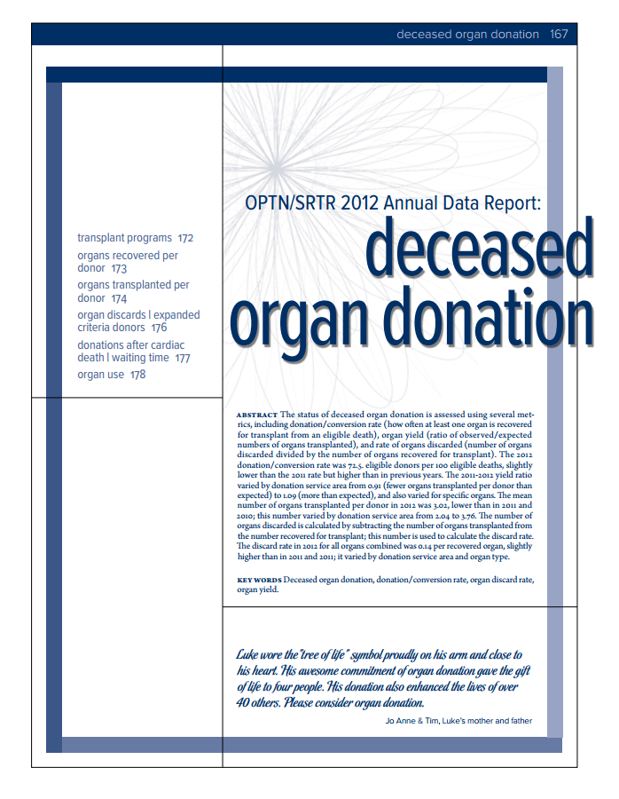
Re-design Inspiration
Graphics from the Organ Procurement and Transplantation Network (OPTN) Annual Data Report
Section on Deceased Organ Donation
The OPTN is a public-private partnership that links all parties involved in the donation and transplantation system
Records and manages all data on the transplant system in the US
[1][2]

Slide 3
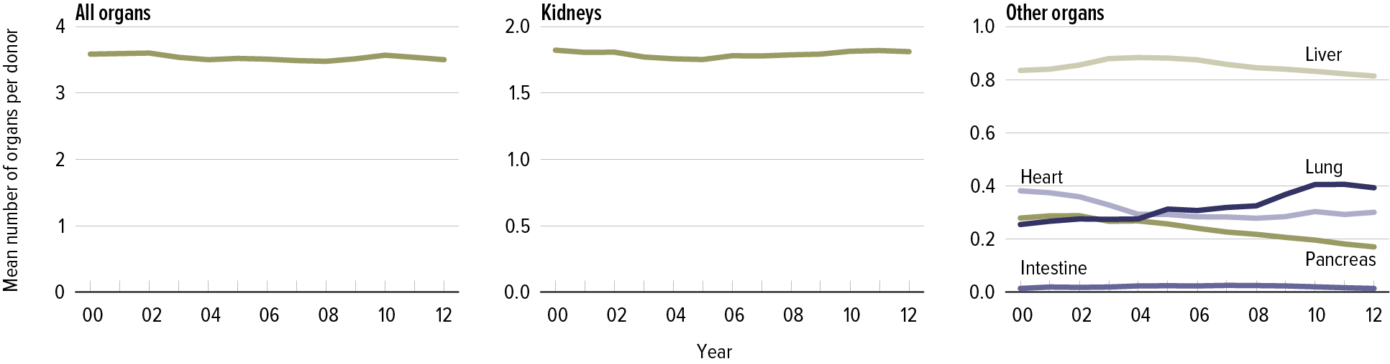
Organ Recovery and Transplant
DOD 2.1 Organs recovered per donor (ORPD)

Slide 4
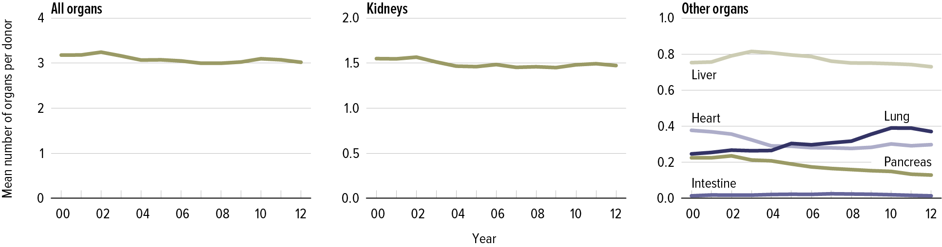
Organ Recovery and Transplant
DOD 3.1 Organs transplanted per donor (OTPD)

Slide 5
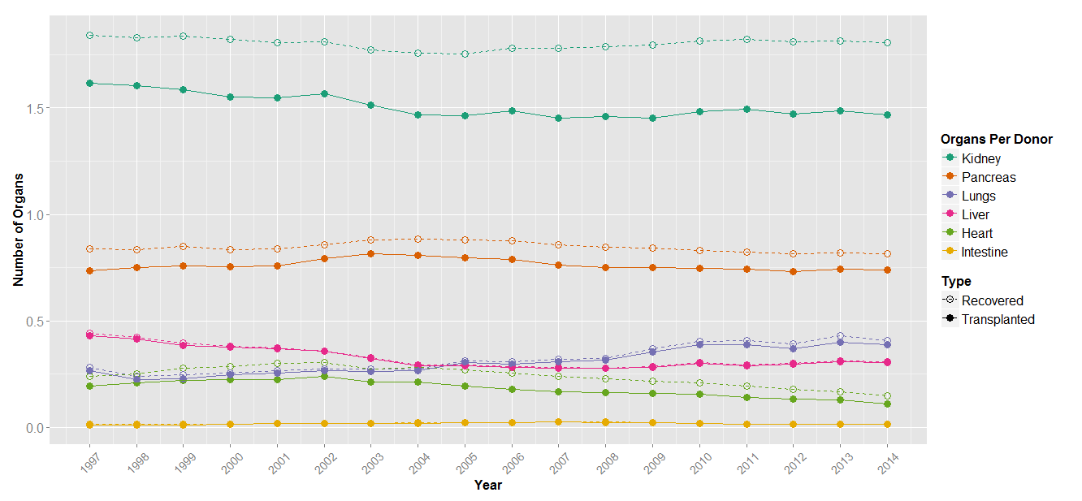
Organ Recovery and Transplant Redesign

Slide 6
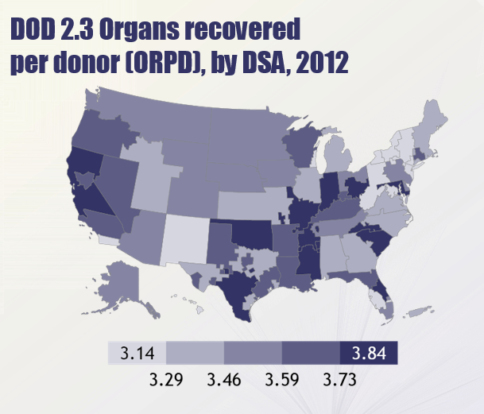
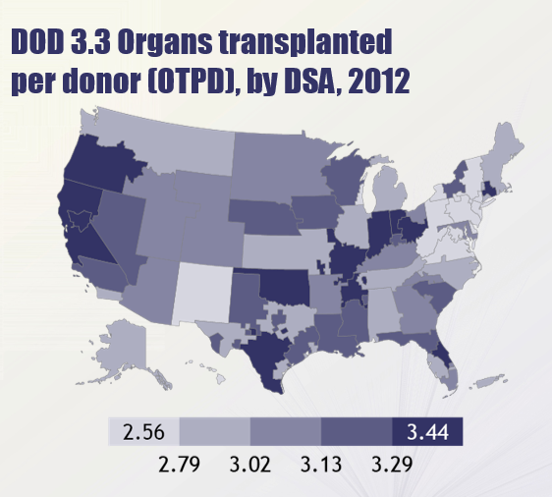
Organ Recovery and Transplant

Slide 7
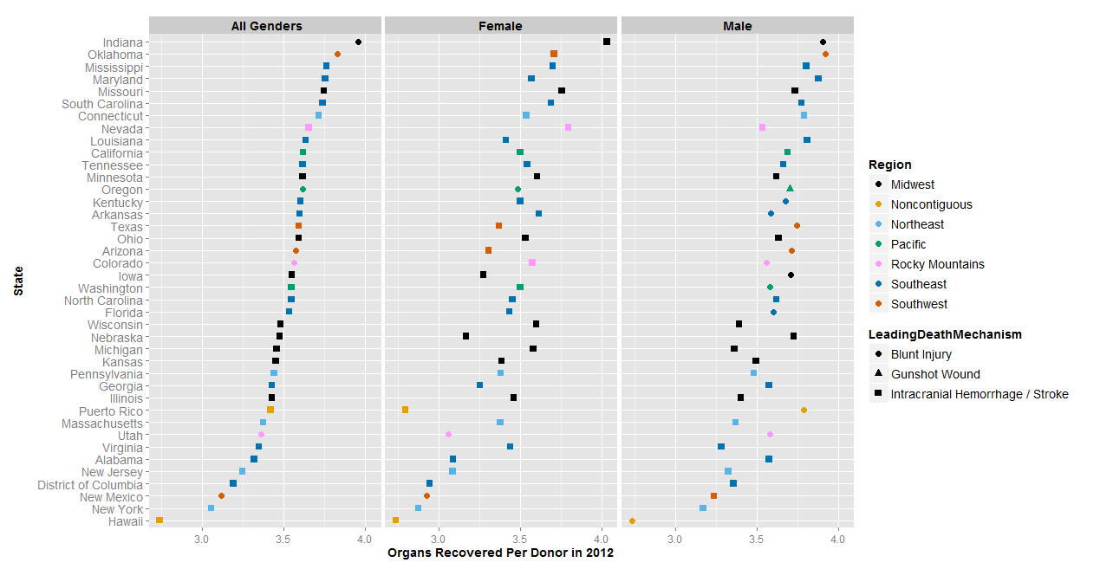
Organ Recovery and Transplant – Redesign

Slide 8
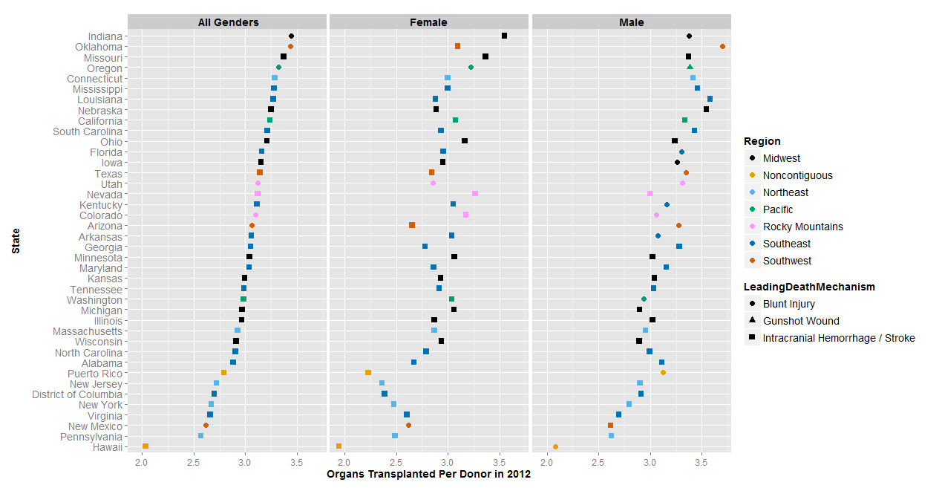
Organ Recovery and Transplant – Redesign

Slide 9
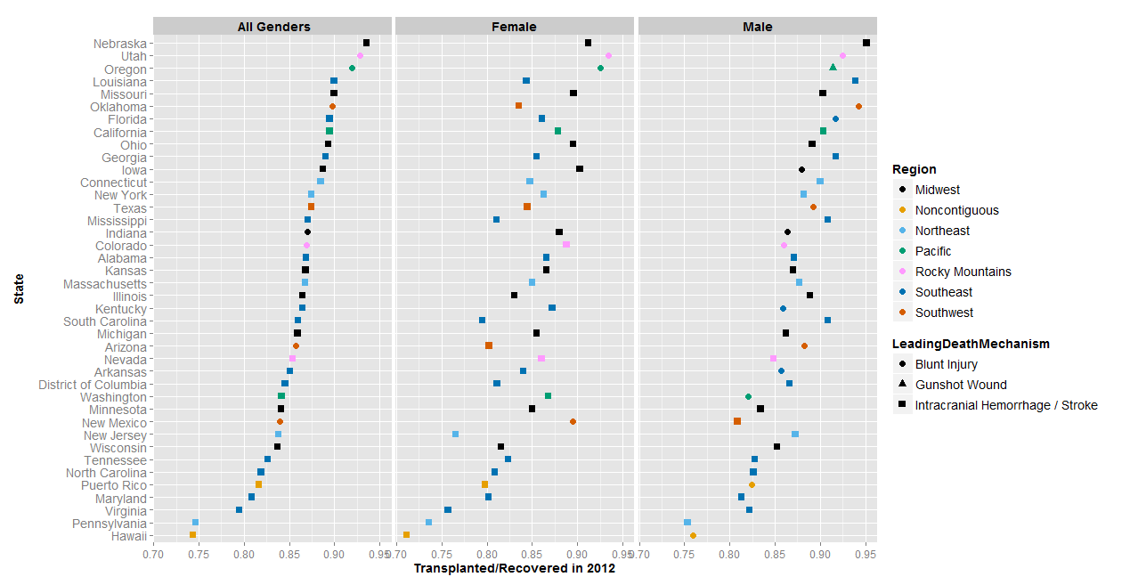
Organ Recovery and Transplant – Redesign

Slide 10
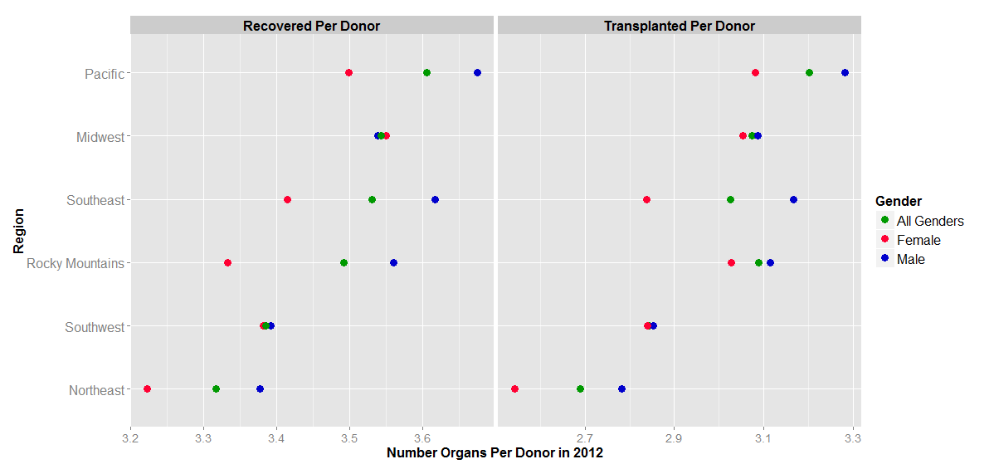
Organ Recovery and Transplant Regional Redesign

Slide 11
References
[1] 2012 Annual Report of the U.S. Organ Procurement and Transplantation Network and the Scientific Registry of Transplant Recipients. Department of Health and Human Services, Health Resources and Services Administration, Healthcare Systems Bureau, Division of Transplantation, Rockville, MD; United Network for Organ Sharing, Richmond, VA; University Renal Research and Education Association, Ann Arbor, MI. (http://srtr.transplant.hrsa.gov/annual_reports/2012/Default.aspx)
[2] Organ Procurement and Transplantation Network, "Organ Procurement and Transplantation Network," 17 October 2014. [Online]. Available: http://optn.transplant.hrsa.gov/.
[3] Annual Estimates of the Resident Population for the United States, Regions, States, and Puerto Rico: April 1, 2010 to July 1, 2012 (NST-EST2012-01)

